Slide 1
Traffic sign identification
project
Submitted by:
Ruchi Tiwari

Slide 2
Imported all these Libraries
import pickle
import csv
import matplotlib.pyplot as plt
%matplotlib inline
import matplotlib.mlab as mlab
import random
import numpy as np
import cv2
import random
from sklearn.utils import shuffle
import tensorflow as tf
from tensorflow.contrib.layers import flatten
import os
from os import listdir
from skimage.io import imread

Slide 3
Import the libraries for model building.
import tensorflow as tf
from tensorflow.keras.preprocessing.image import ImageDataGenerator
from tensorflow.keras.models import Sequential
from tensorflow.keras.layers import Dense, Dropout, Activation, Flatten
from tensorflow.keras.layers import Conv2D, MaxPooling2D
from tensorflow.keras.callbacks import TensorBoard

Slide 4
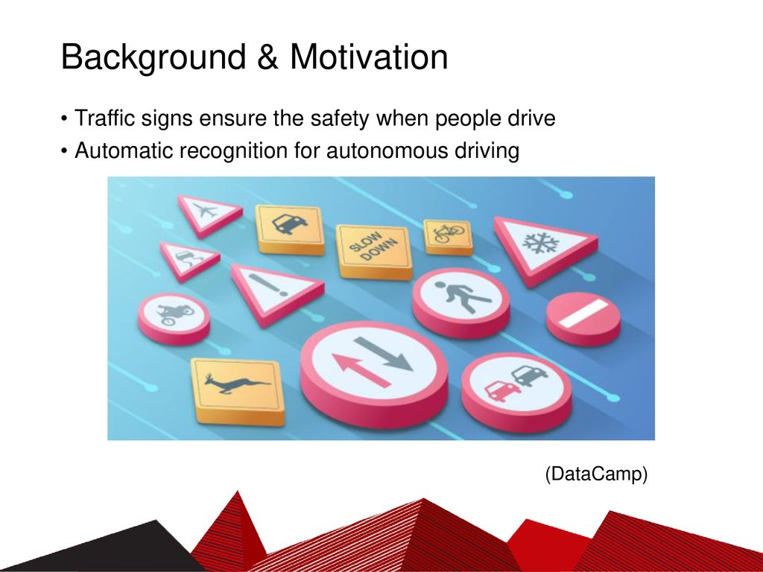
Background
Traffic sign ensure the safety when people drive
Automatic recognition for the autonomous driving

Slide 5
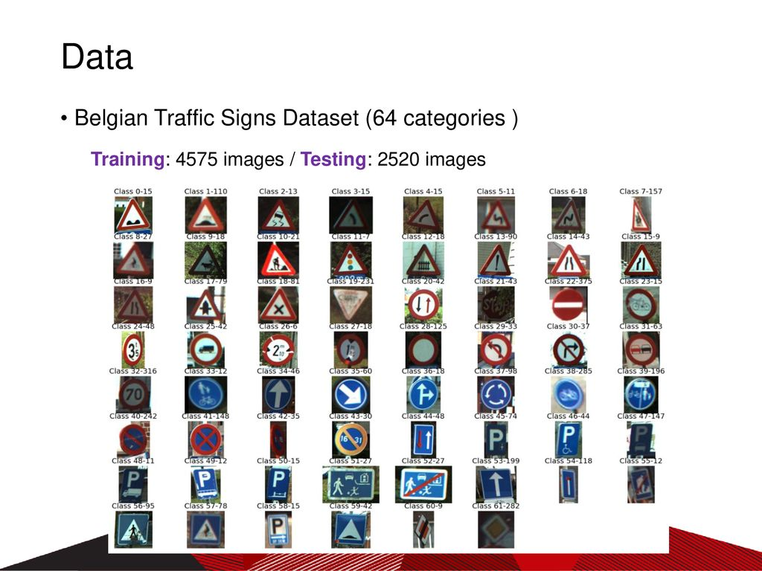
The dataset contains more than 50,000 images of different traffic signs. It is further classified into 43 different classes

Slide 6
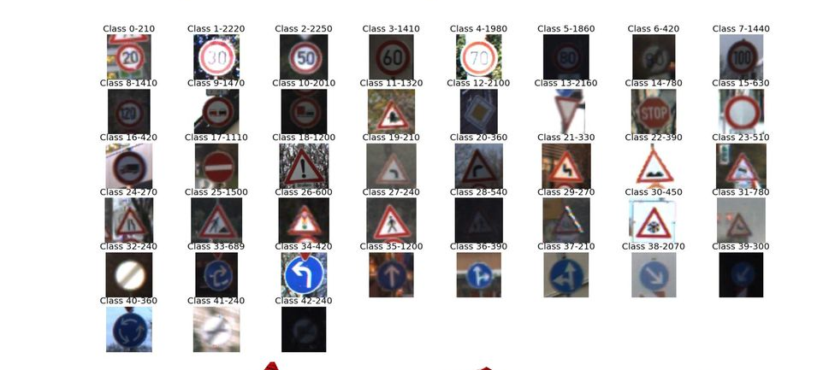
Number of training examples = 34799 Number of validation examples = 4410 Number of test examples = 12630 Image data shape = (32, 32, 3) Number of classes = 43

Slide 7
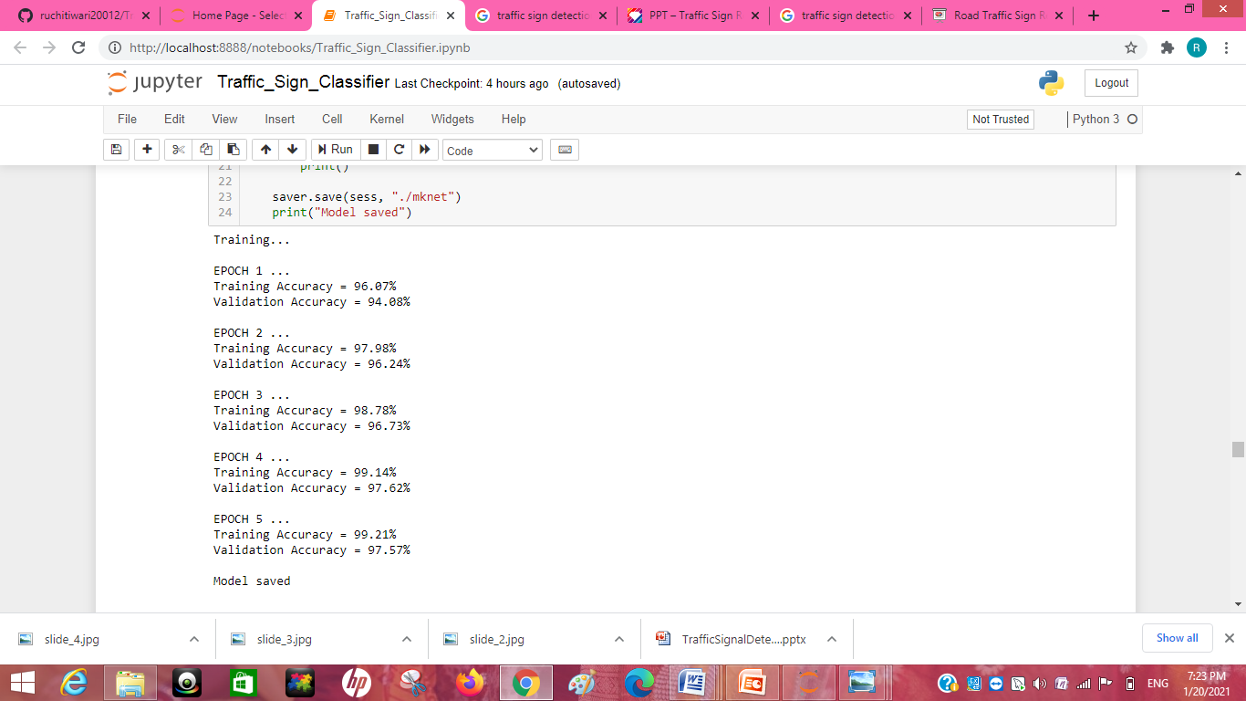
Result

Slide 8
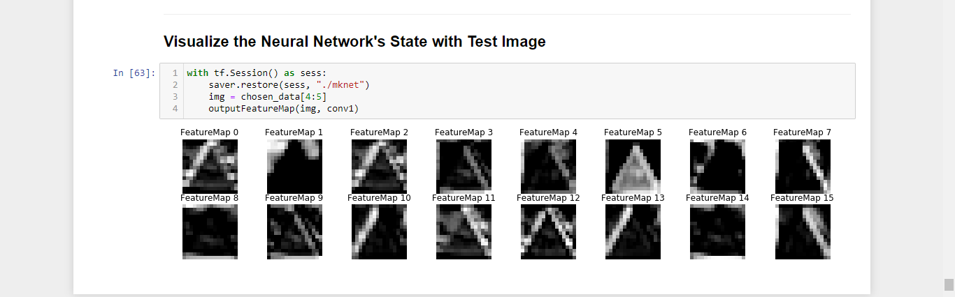
Visualize the Neural Network state with Test Image

